Slide 1
Presentation Phase-III SINGLE PAGE E-COMMERCE WEB APPLICATION By
Md Taneemul Hasan Bhuiyan | 2191081031 | 47 (A DAY)
Alamin | 2191081030 | 47 (A DAY)
Nusrat Jahan Rita | 2191081015 | 47 (A DAY)
Md Mazedul Hoque | 2191081033 | 47 (A DAY)

Slide 2
Abstract
Recently the e-commerce platform is playing an important role in the world. Its activities are a subset of e-business activities. They aimed at developing a reliable e-commerce website using a single-page application for making it faster and more comfortable. Developing effective well-designed, fast, single-page web pages. To implement the selling online website, it needs to use current technologies to achieve this goal.
Keywords: E-commerce, Secure, Single page, verification, Payment Gateway, Customer Service.

Slide 3
Introduction
This project basically is an E-commerce web application. In this project, we applied different strategies to solve the different problem statements or drawbacks. Basically, our goal is to develop an single page E-commerce web application in such a way that we try to give a very decent user experience. We solve the slow web page rendering to provide the user a good experience when they will visit the web application. To solve this problem we used single page web application technique to fast-loading webpage and their data as well.

Slide 4
Problem Statements
Lack of Product Information
Not Secure in Opening Account
Poor Customer Service
Hiding Contact Information
Confusing Checkout process
Lack of Payment Options
Not Including Related Products
Not Including Shipping Information
Order Confirmation email.

Slide 5
Project Objectives
To give customer friendly user interface
To grant advanced security features.
To keeping expenditures within the effective-cost.
To make responsiveness in Web.
To increase sales & business condition.

Slide 6
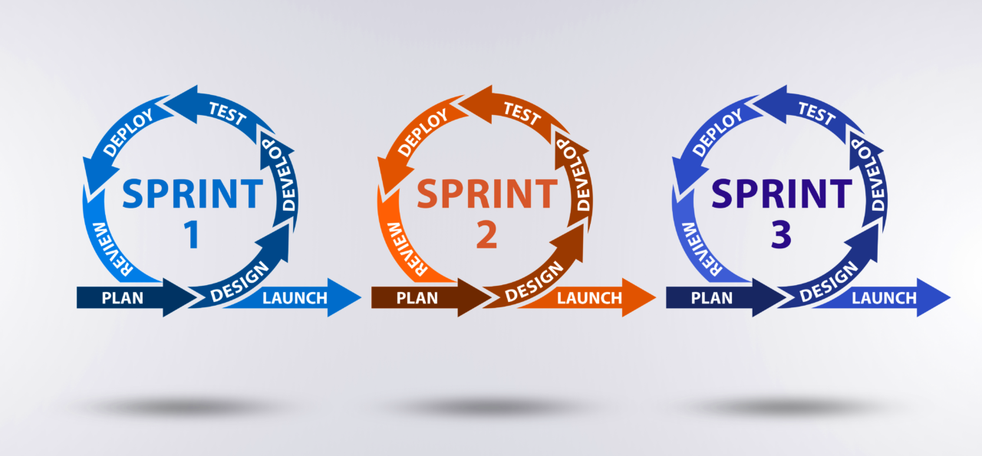
Project Methodology
We used AGILE methodology because we build our e-commerce website and also build A system so that customers can see our site first and easily. Agile methods break the product into small incremental builds. These builds are provided in iterations. That's why we will part our project into lots of parts or modules like authentication system, email processing, payment system, authentication, email system, product display, order product system, payment system, analysis, merge all & unit test, test altogether etc.
Figure1: Agile Methodology for Single page E-commerce Web Application.

Slide 7
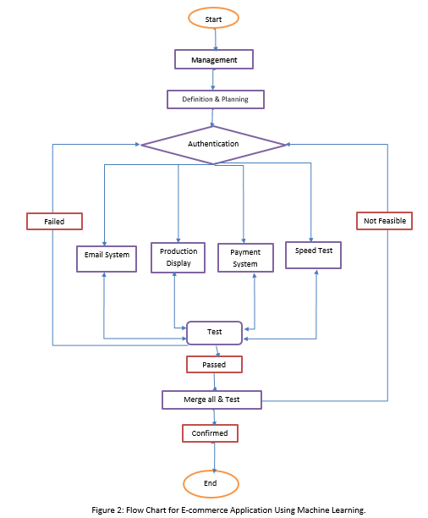
Flow Chart
Figure 2: Flow Chart for Single page E-commerce Web Application.

Slide 8
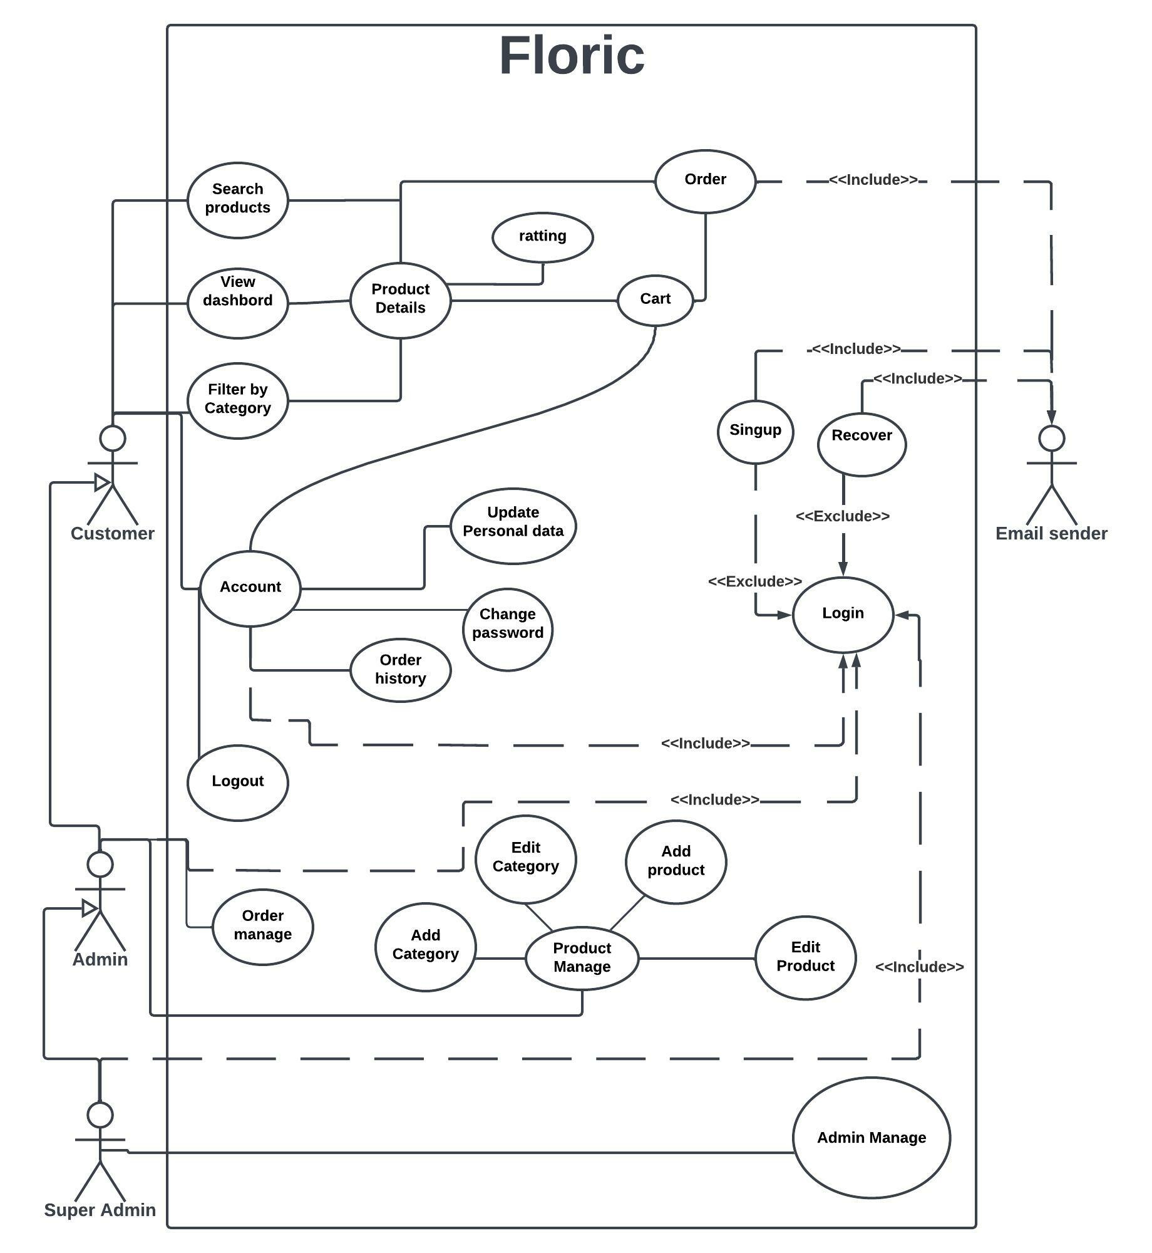
Use Case Diagram
Figure 3: Use Case Diagram for Single page E-commerce Web Application.

Slide 9
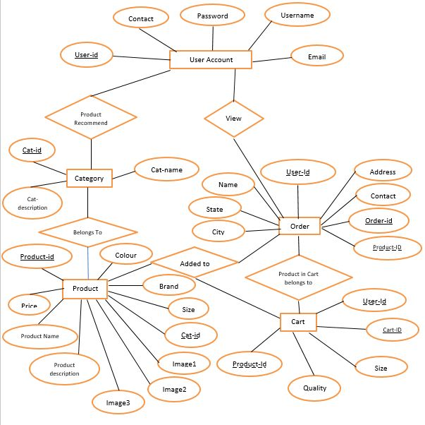
ER Diagram
Figure 4: ER Diagram for Single page E-commerce Web Application.

Slide 10
Implementation
Dashboard
Profile
Authentication System
Order System
Admin Panel
Advance Technologies

Slide 11
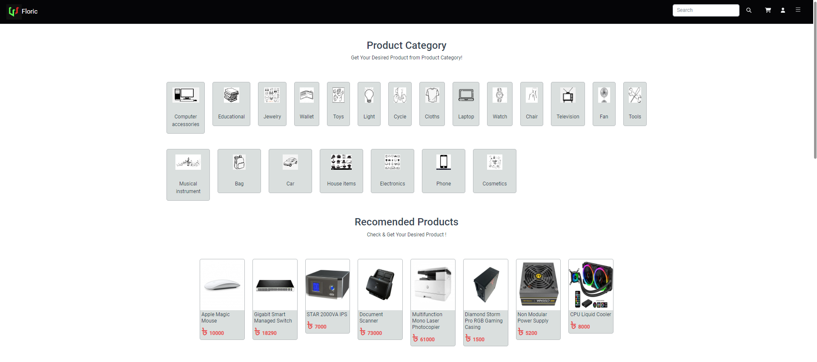
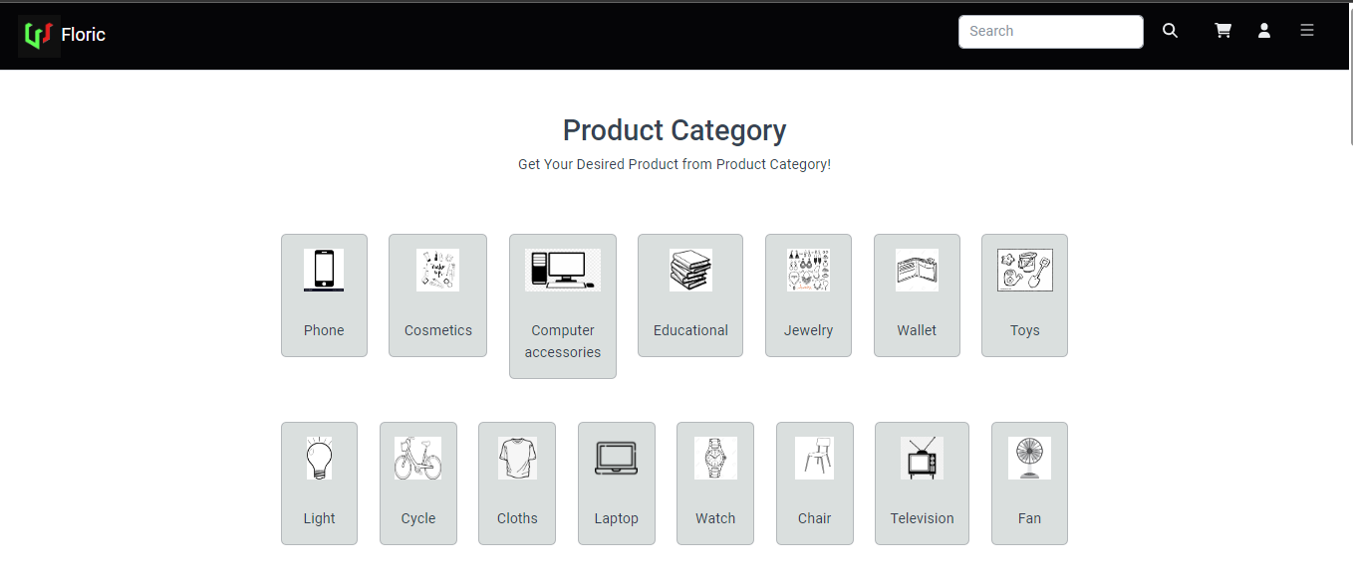
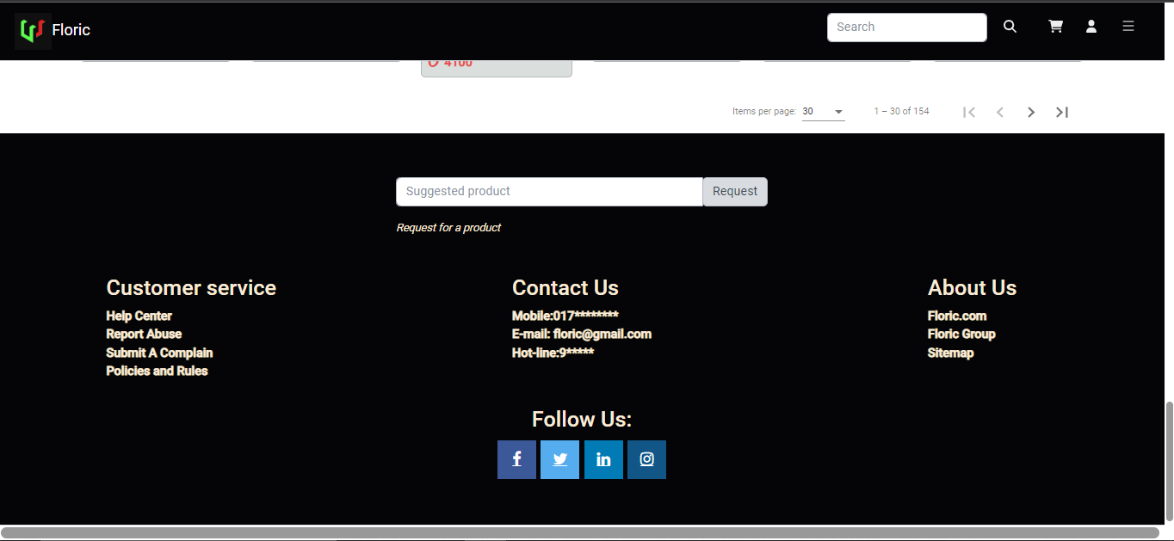
Dashboard

Slide 12
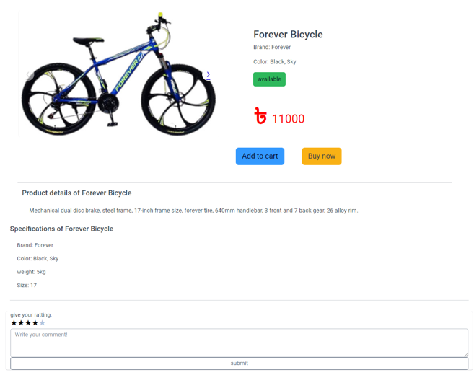
Dashboard (Product)

Slide 13

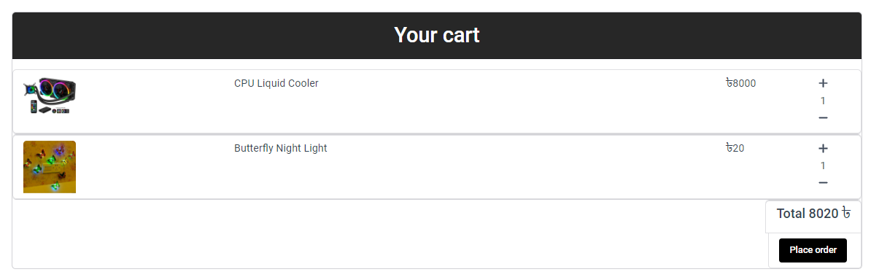
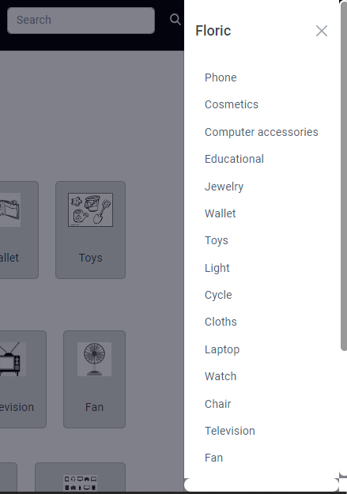



Slide 14
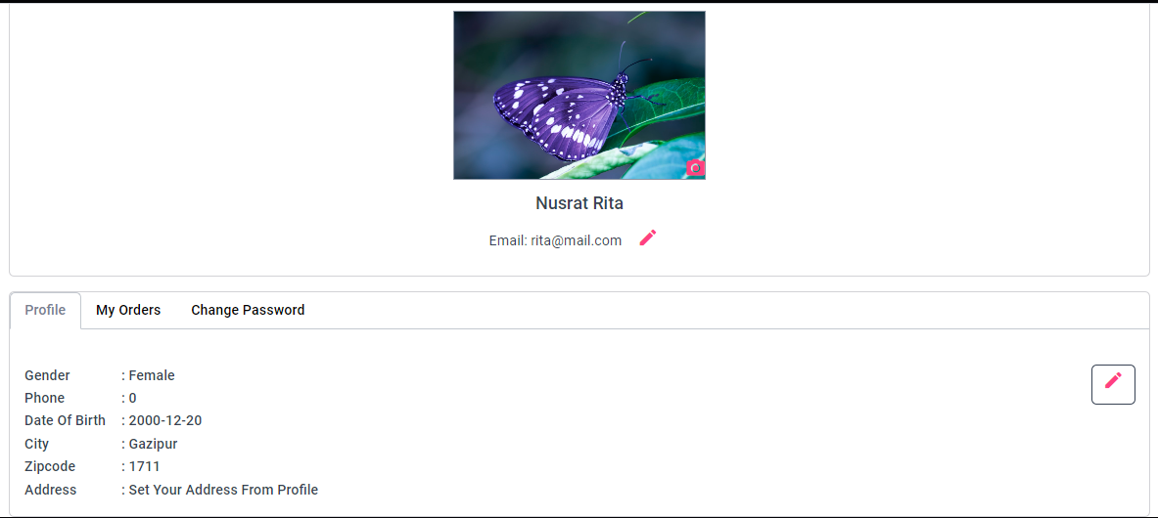
Profile

Slide 15
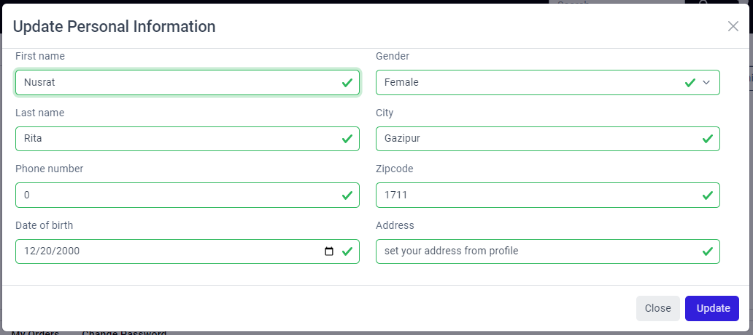
Profile (Update Personal Information)

Slide 16
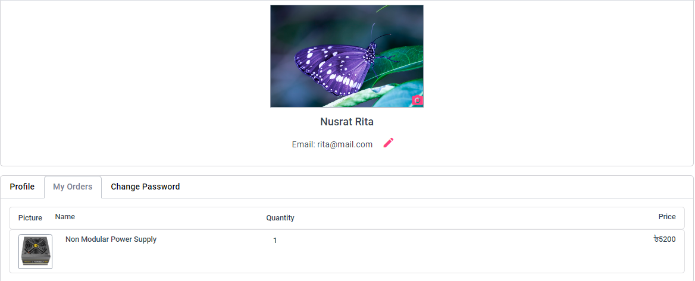
Profile (My Orders)

Slide 17
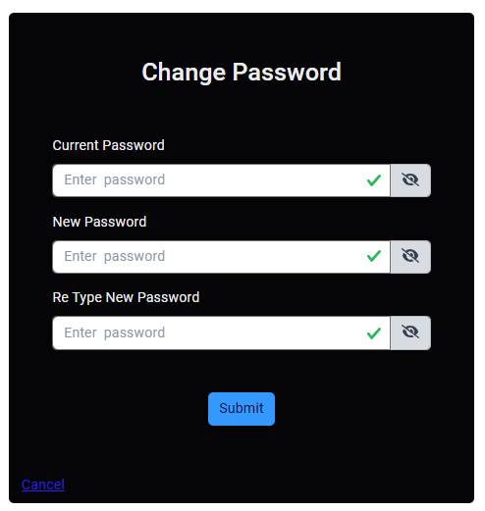
PROFILE (Change Password)

Slide 18
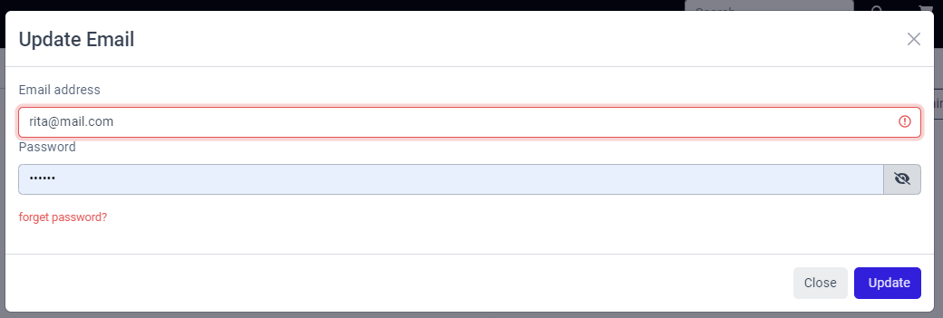
PROFILE (Update Email)

Slide 19
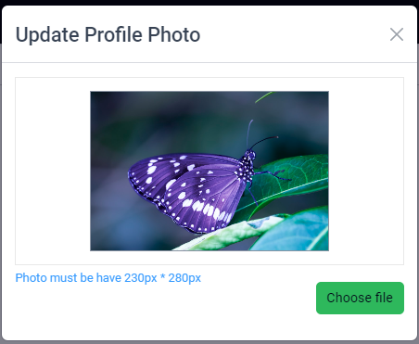
Profile (Update profile photo)

Slide 20
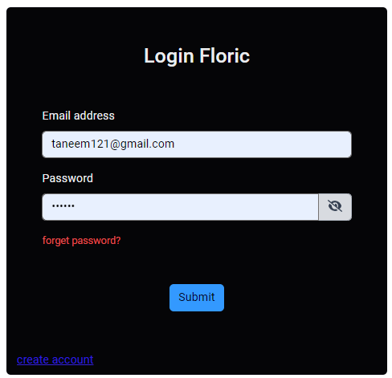
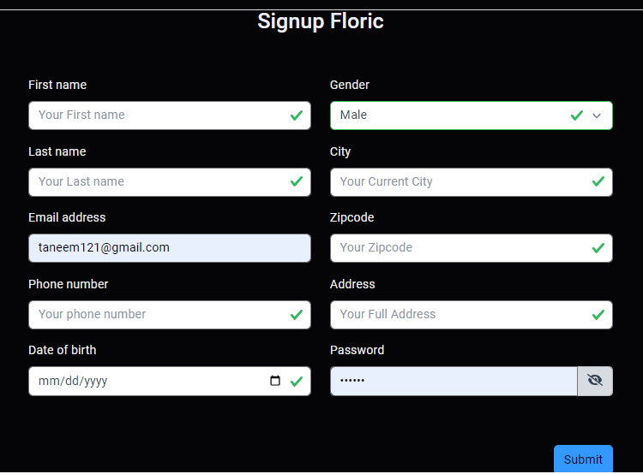


Authentication System (create or login)

Slide 21
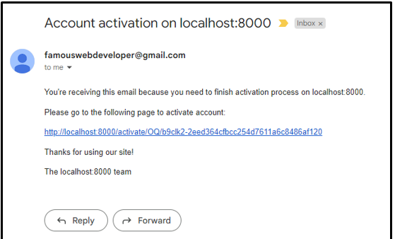
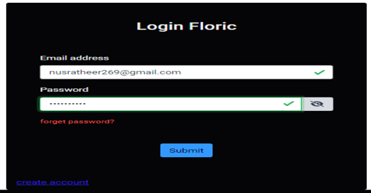


Authentication System (create Account)

Slide 22
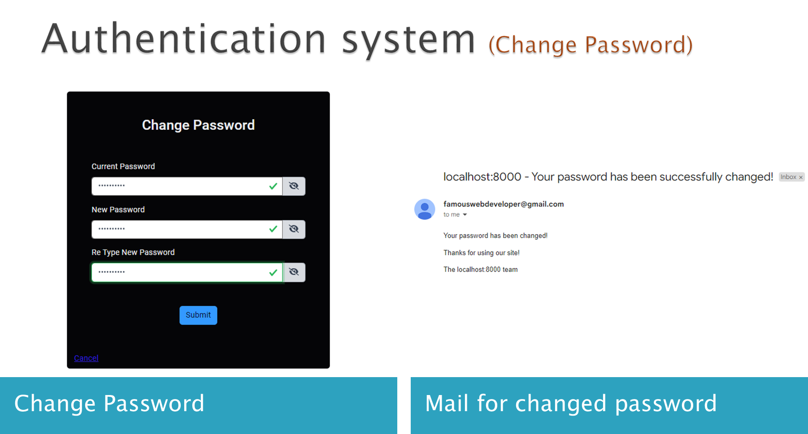

Slide 23
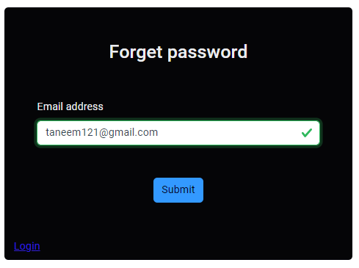
Authentication system (Forget Password)
Click on Forget Password
Give user gmail

Slide 24
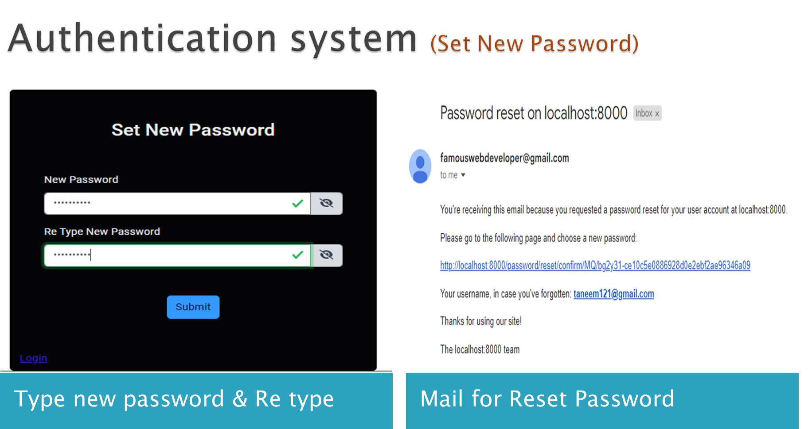

Slide 25

Authentication system (Log out)

Slide 26
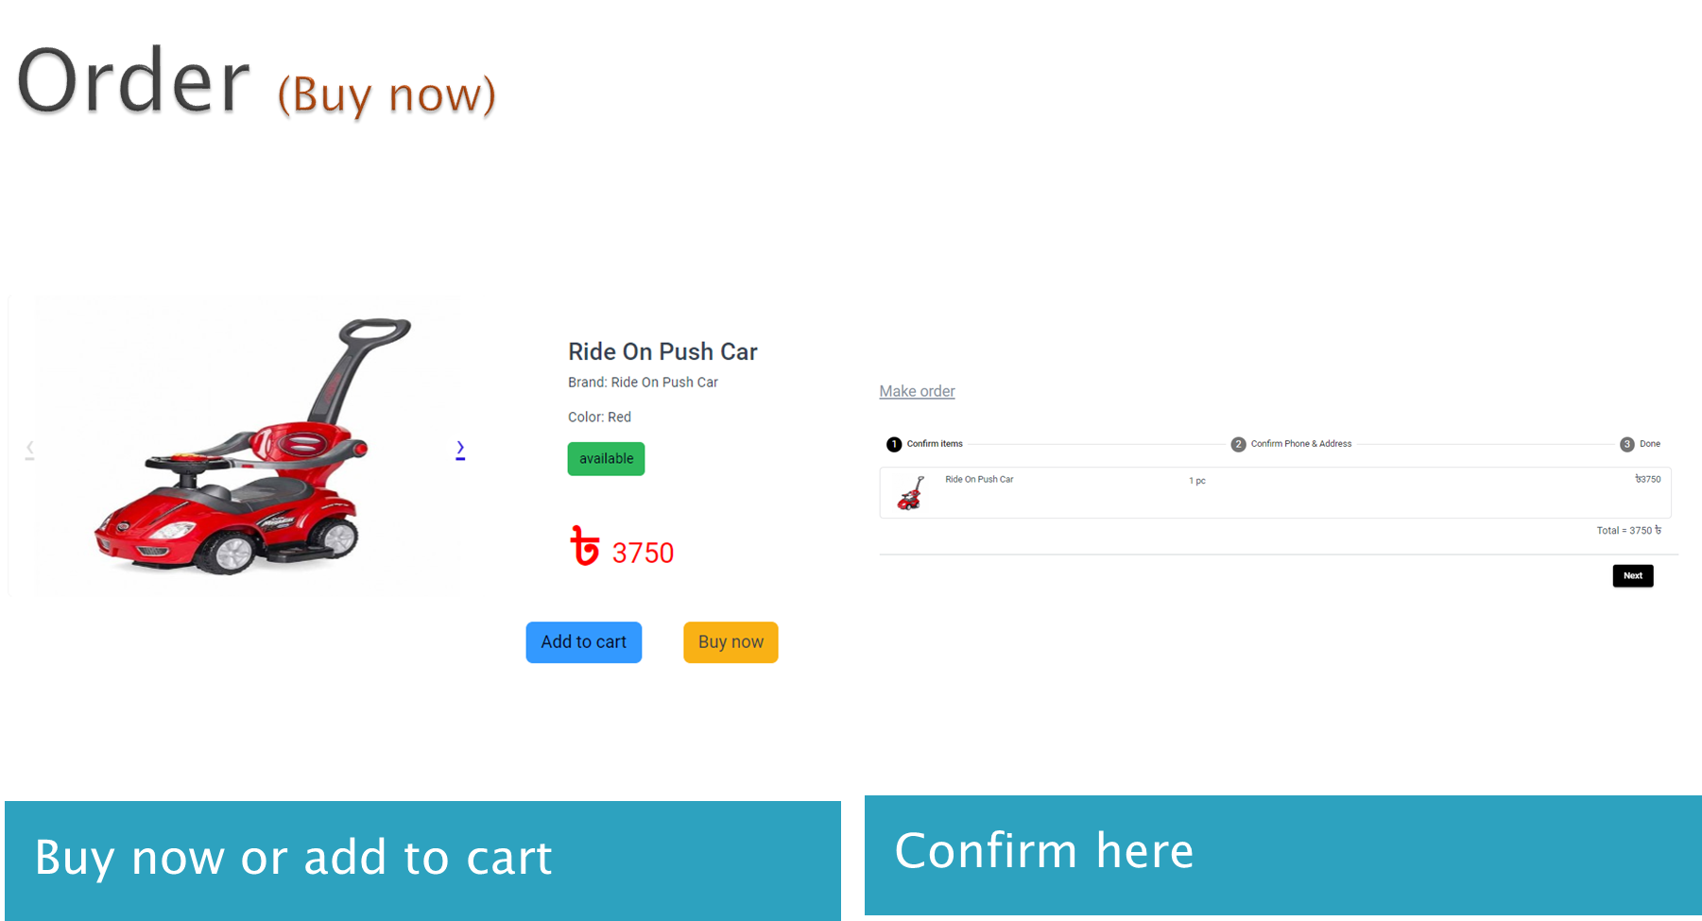

Slide 27
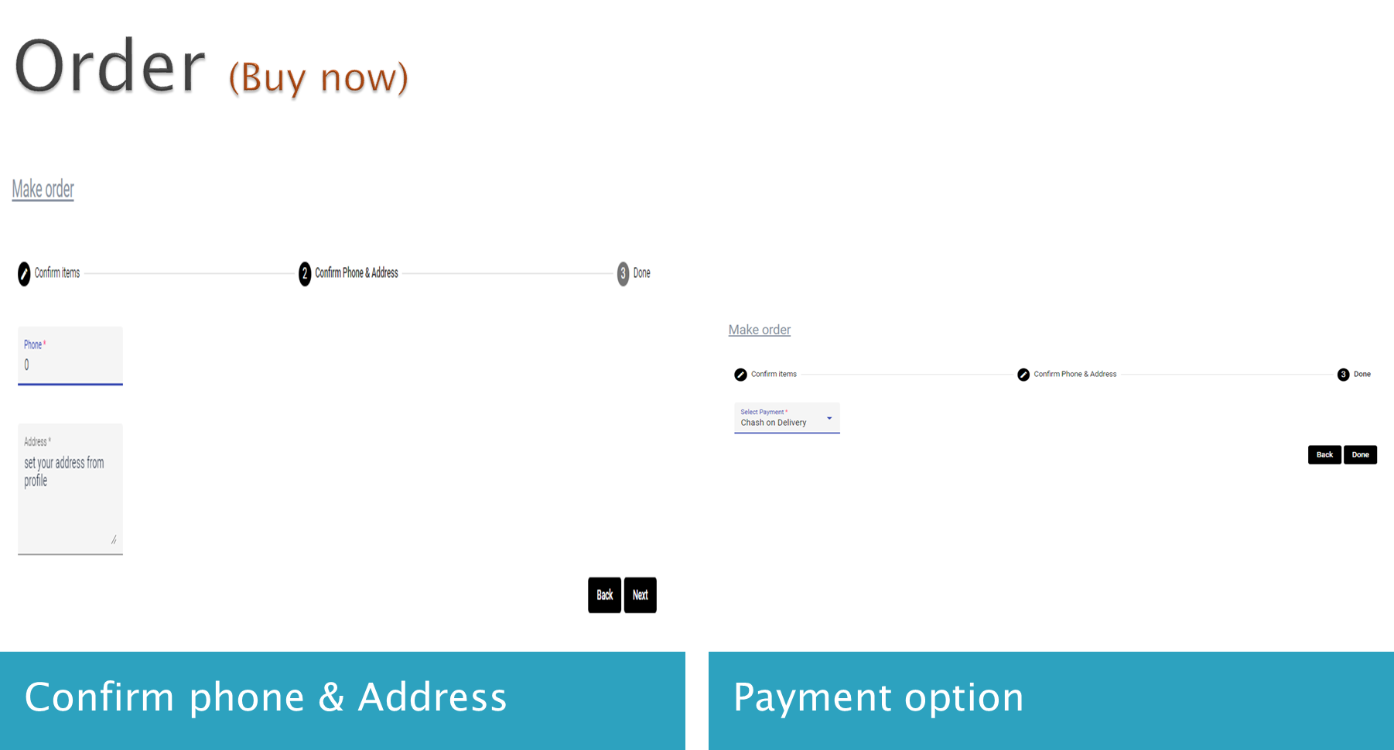

Slide 28
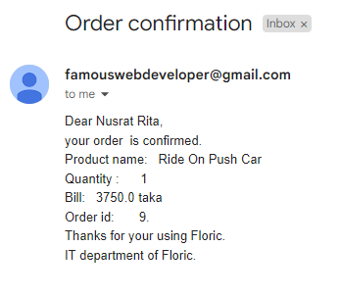
Order (Buy now)

Slide 29
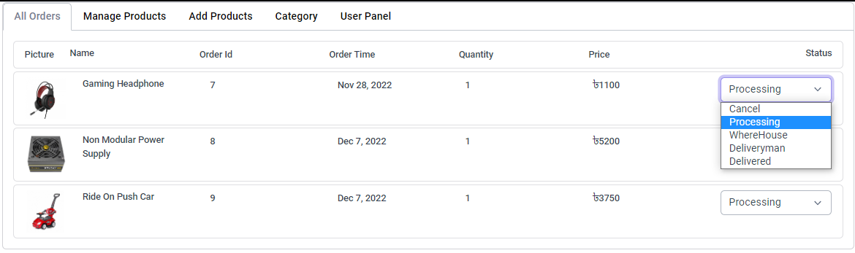
Admin Panel (All Orders)

Slide 30
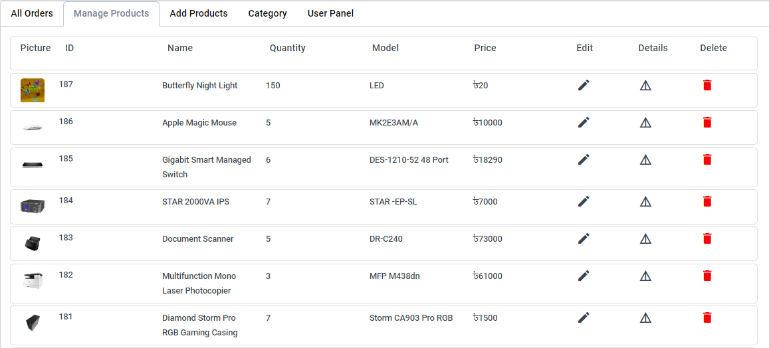
Admin Panel (Manage Products)

Slide 31
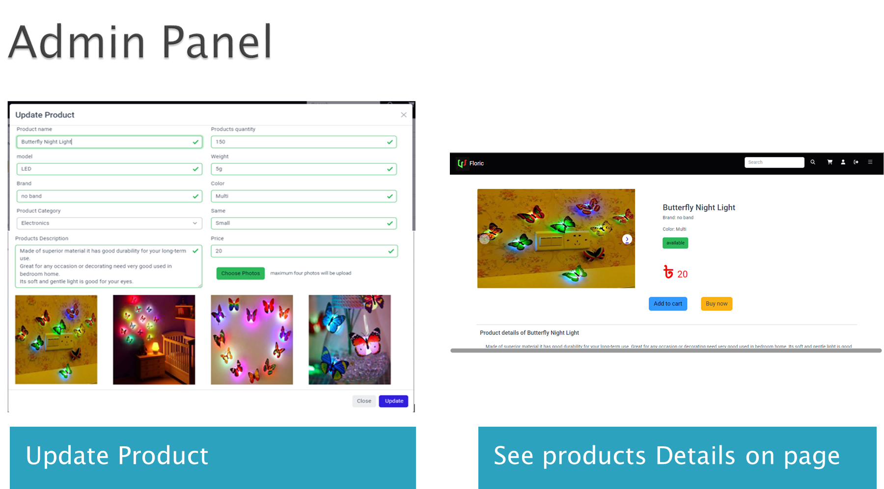

Slide 32
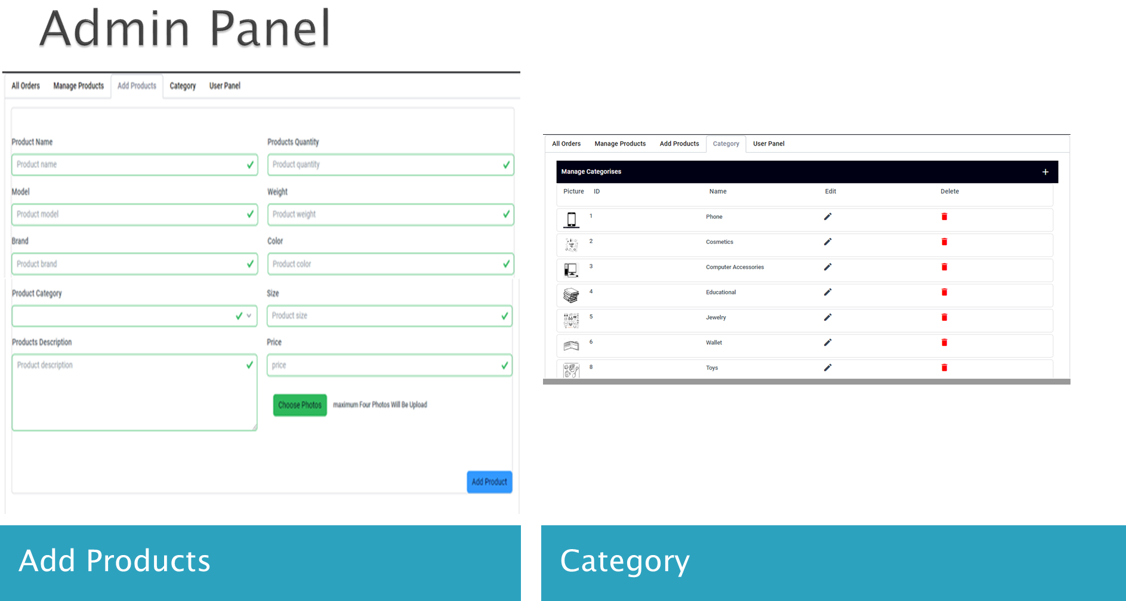

Slide 33
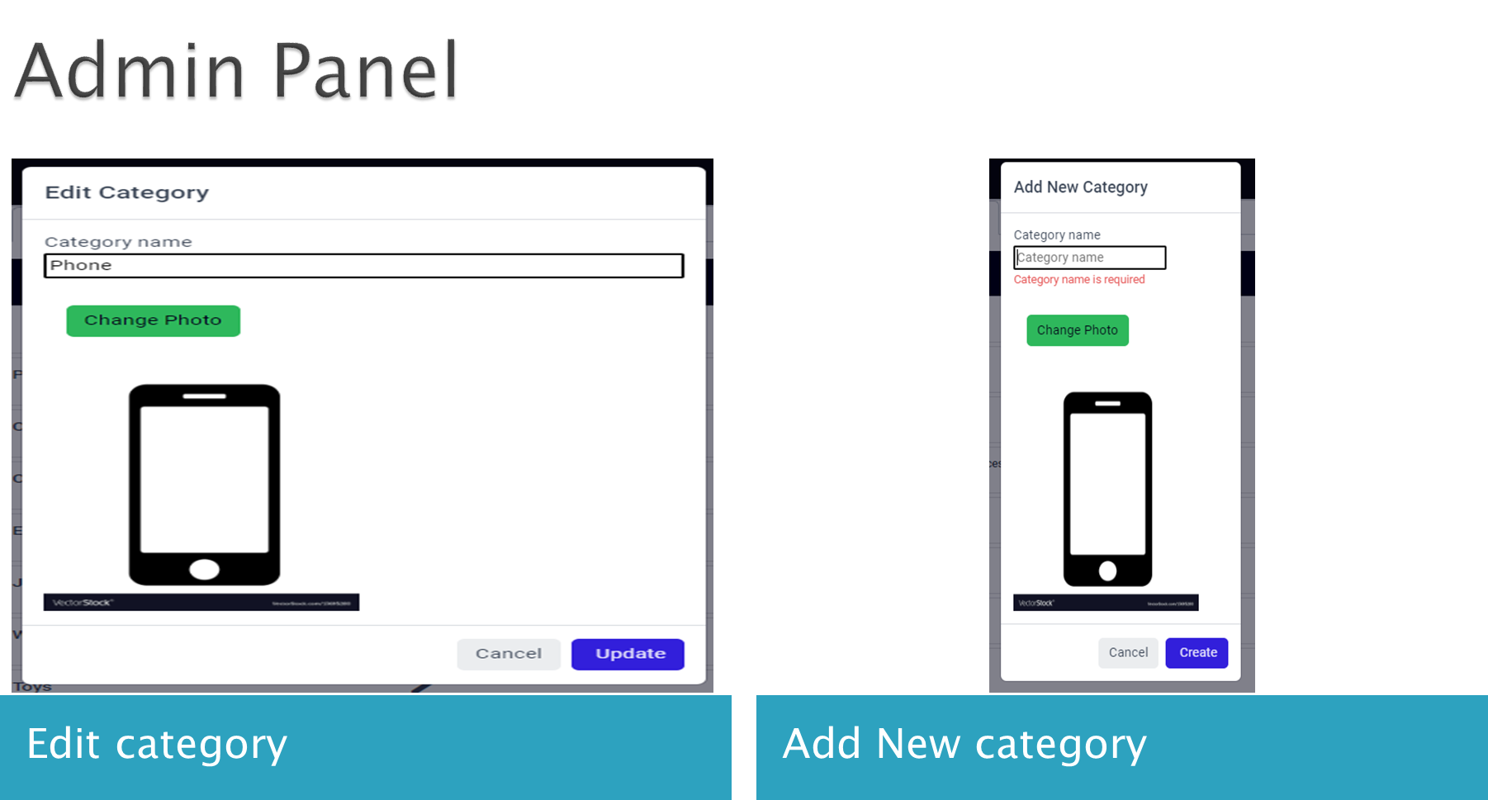

Slide 34
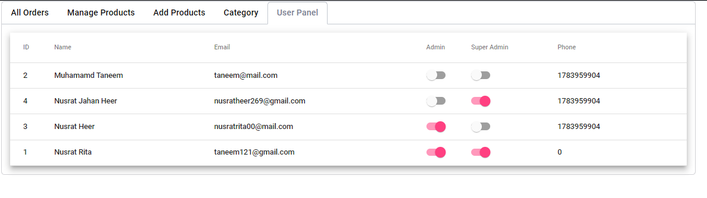
Only Super Admin

Slide 35
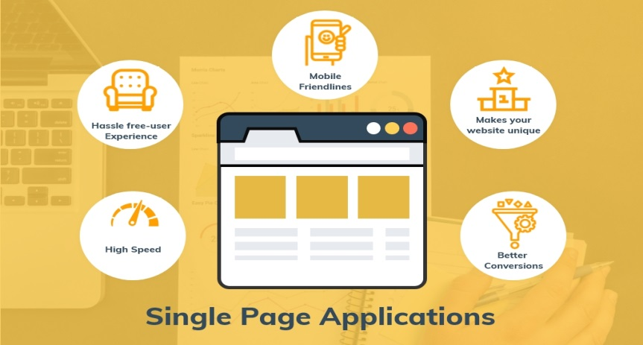
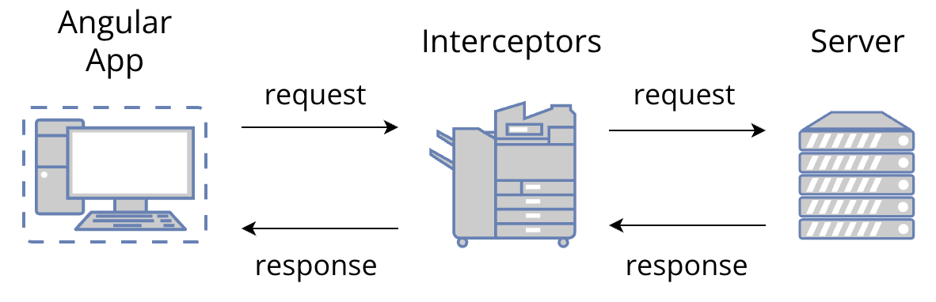
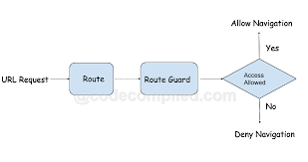
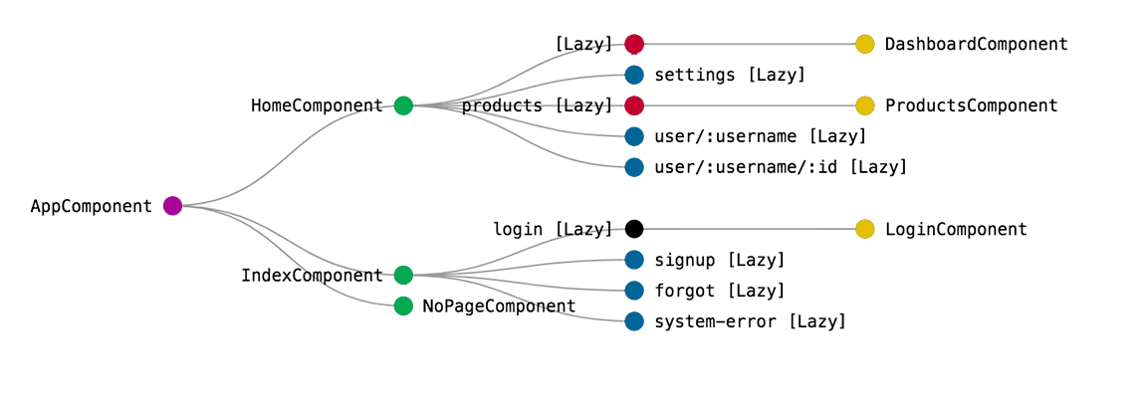
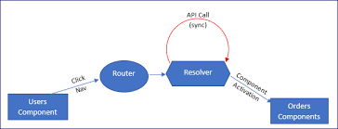
ADVANCED TECHNOLOGIES
Image-1 : Single Page Applications
Image-2 : Interceptors
Image-3 : Guard
Image-4 : Lazy Loading
Image-5 : Resolver

Slide 36
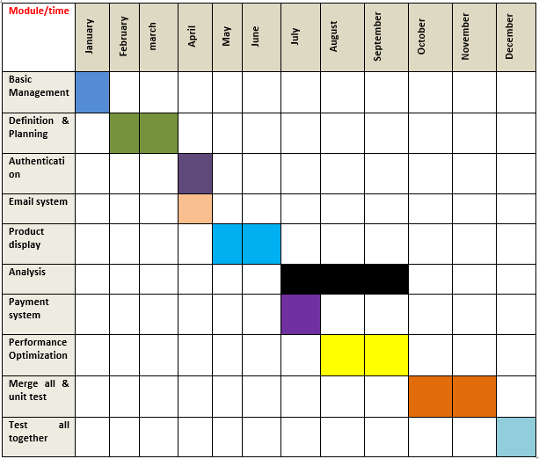
Project Plan & Time Table
Figure 4: Time Table for E-commerce Application Using Machine Learning.

Slide 37
Conclusion
In our project, we have developed a single-page web application system. Where customers can open an account, order products, see product details, and make ratings & comments. Also, admins can add or remove products & categories, change product status, and super admin can see users and also can make them admin & super admin. In the future, we can implement a content base recommendation system that recommends customers' other products depending on their selected product. Our future plan is customer behavior analysis.

Slide 38
References
1. E-commerce website: https://onlineshoppingbd.org/bagdoom-com/
Visited Date: 03 JANUARY,2022
2. Django documentation: https://docs.djangoproject.com/en/4.0/
Visited Date: 08 JANUARY,2022
3. Django rest-framework documentation: https://www.django-rest-framework.org/
Visited Date: 12 JANUARY,2022
4. Angular documentation: https://angular.io/docs Visited Date: 18 JANUARY,2022
5. E-commerce website: https://www.startech.com.bd/ Visited Date: 23 JANUARY,2022
6. E-commerce website: https://chaldal.com/ Visited Date: 23 JANUARY,2022
7. E-commerce research paper: https://www.researchgate.net/publication/304703920_A_Review_Paper_on_E-Commerce
Visited Date: 25 JANUARY,2022

